Slide 1
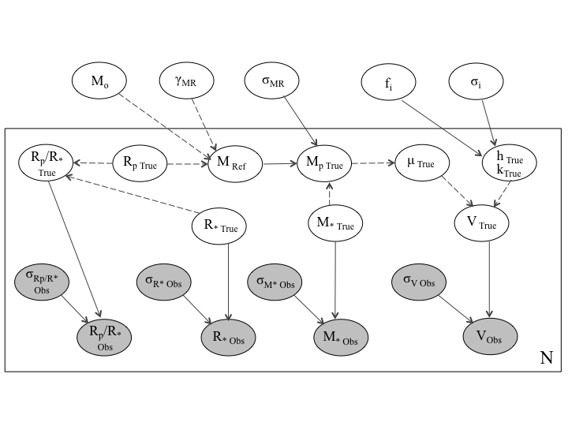
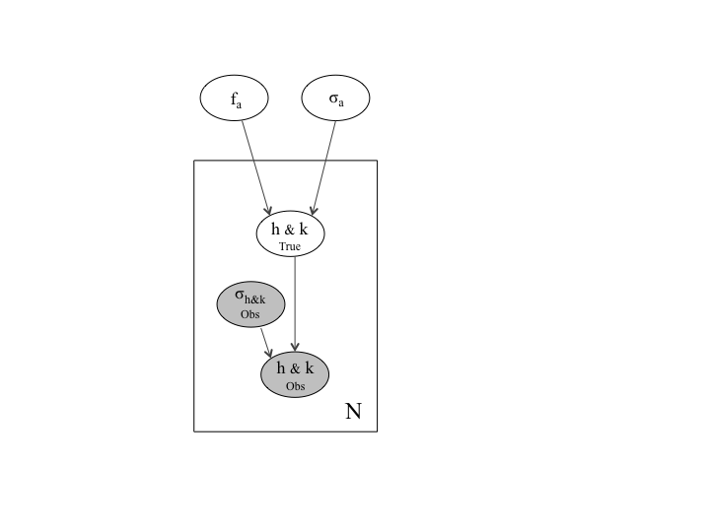
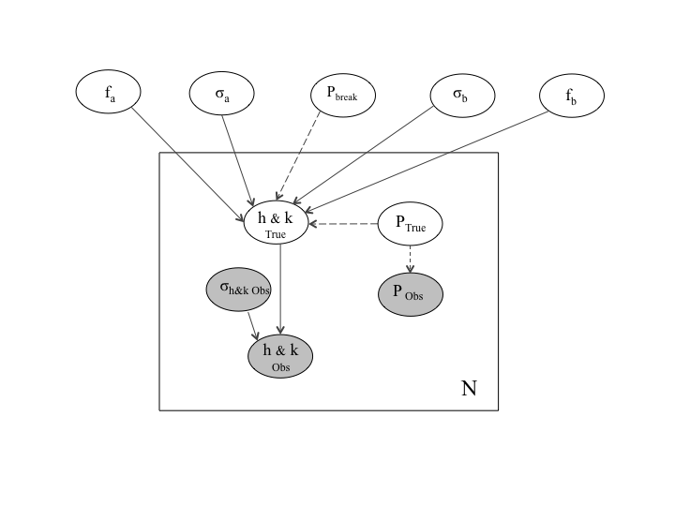
Introduction to Hierarchical Bayesian Models
Megan Shabram
September 21, 2017

Slide 2
Reporting point estimates manufactures false confidence. Better to report probabilistic parameter estimates via full posterior distributions.

Slide 3
Hierarchical Bayes:
Probabilistic modeling of populations or groups.

Slide 4
Why Hierarchical Bayesian Modeling?
The uncertainty unique to each observation can be propagated into the estimation of the population parameters.
Selection effects can be modeled and incorporated into the inference. (e.g., groups of observations of the same objects from different instruments)
Information about each object in the population is used to make inferences about one another. Objects “pool and muster strength” (a.k.a. “shrinkage”).
Can handle large measurement uncertainty, censored data (upper limits), and missing data.
Naturally handles over-fitting

Slide 5
What kinds of things might we want to learn by using HBM in Astronomy?
If the distribution of interest is correlated with other properties it may shed light on interesting physics.
What is the typical scale of the population?
Is there evidence for multiple populations?
Do we have many uncertain measurements of the same object?

Slide 6
A few examples in the literature:
Evidence for two Hot Jupiter Formation Paths Nelson et al. 2017
HBM simulated RV exoplanet eccentricities Hogg et al. 2010
Most 1.6 Earth-radius Planets are Not Rocky, Rogers 2015
HBM for exoplanet mass-radius relationship Wolfgang, Rogers, & Ford 2016
The eccentricity distribution of Hot Jupiters from Kepler Shabram et al. 2016
Multi-level model for luminosity distribution of gamma ray bursts Loredo & Wasserman, 1998
HBM for Supernovae Mandel et al. 2009
HBM for galaxy clusters Andreon & Hurn, 2010
HBM for Milky Way satellites Martinez 2015

Slide 7
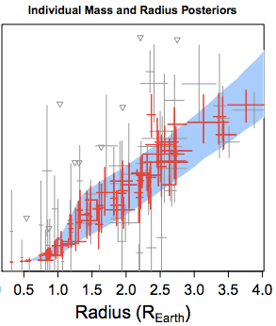
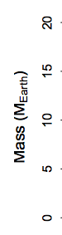
HBM in action: The mass-radius relation
Individual estimates are pulled toward the population mean and overall RMS error is lower“ – example in Wolfgang et al. 2015, Figure 4, arXiv:1504.07557.

Slide 8
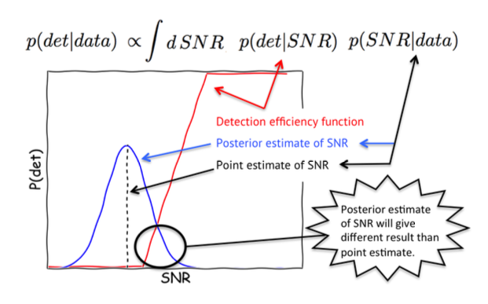
HBM in action: Kepler Occurrence Rates

Slide 9
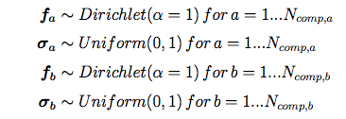
Depicting Hierarchical Bayesian Models
Mathematical equations
Graphical models
Pseudo-code
~ distributed as
<- defined as (data transformations)
e.g., hyperparameters for a mixture model:

Slide 10
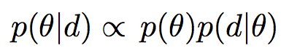
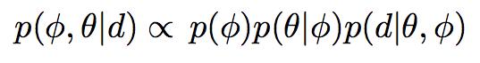
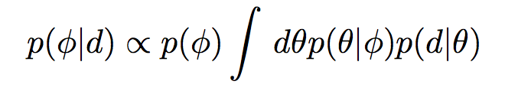
HBM equation generalized
posterior
prior
likelihood
posterior
prior
likelihood
posterior
prior
likelihood

Slide 11
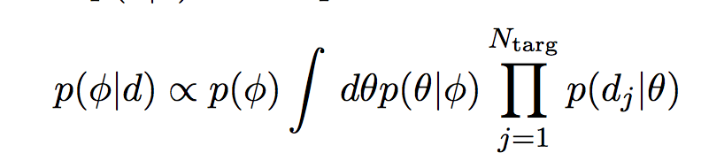
Integrating over the latent variables (population constituents) gives
marginal posteriors for the hyperparameters
If each measurable is independent from another,
they are considered “separable” (product)

Slide 12
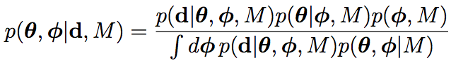
HBM equation generalized
M <- additional information implicit in the model
Notes:
Denominator can be important for model comparison

Slide 13
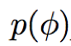
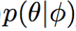
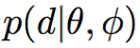
Graphical models for HBM
Hyperparameters/ hyperpriors
Latent variables
Measurables
Physical models vs. probabilistic models

Slide 14
Graphical models for HBM
Hyperparameters/ hyperpriors
Latent variables
Measurables
Physical models vs. probabilistic models
Definition (dotted)
Distribution (solid)

Slide 15
Graphical models for HBM
Hyperparameters/ hyperpriors
Latent variables
Measurables
Physical models vs. probabilistic models
Questionable

Slide 16
Summarizing Posterior Distributions
Reporting posteriors is good practice in open reproducible science.
1d and 2d marginal distributions
Integrate over all other parameters to get a 1d marginal
The values used in the MCMC iterations (from a “not-not” converged) numerical simulation are mathematically equivalent to the marginal distributions.
Get 1d marginal by plotting histogram of iterations for one parameter
Get 2d marginal by plotting the vector of iterations for 2 parameters against each other (scatter plot)
KDE for 2D marginal
95% equal tailed credible interval: The interval containing the median, containing 95% of the probability.

Slide 17
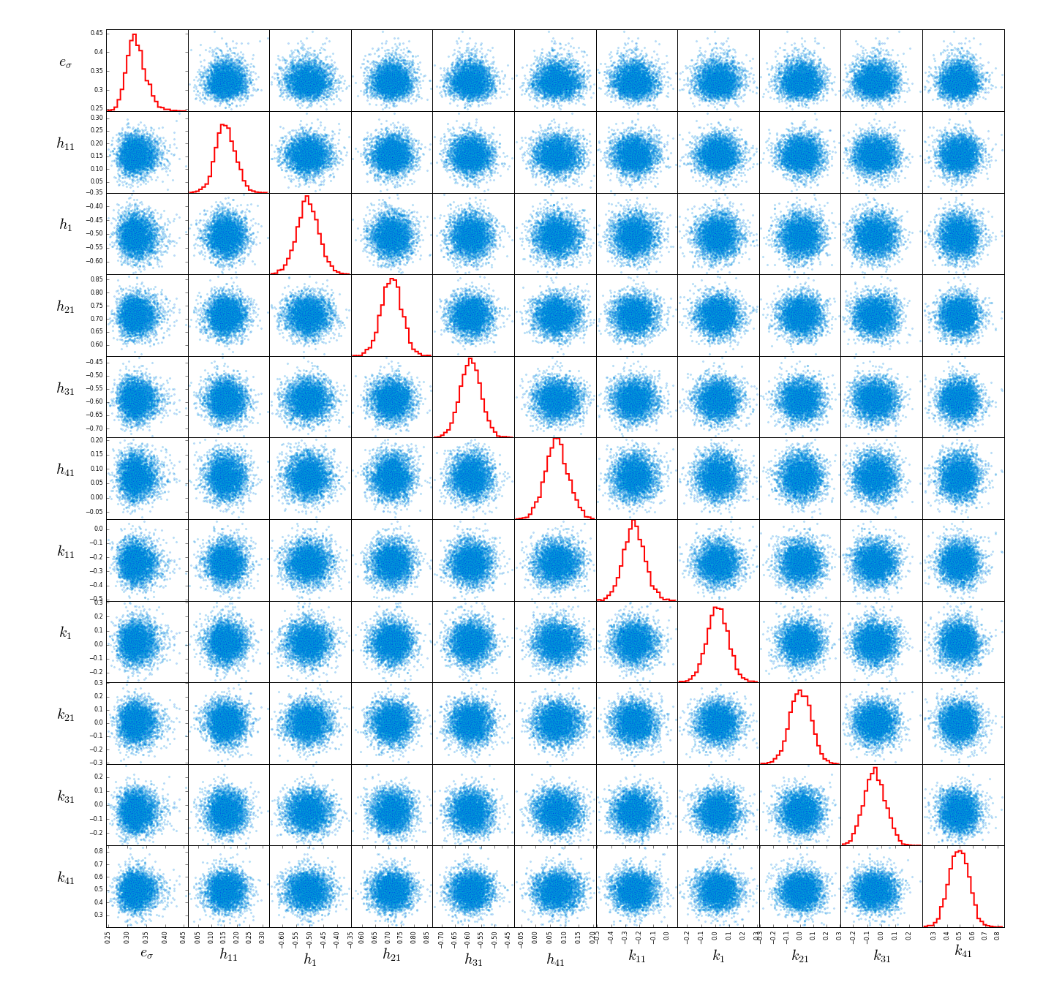
Summarizing Posterior Distributions

Slide 18
Software for HBM
Stan
JAGS
PyMC3
TensorFlow
Software is open source and maintained. Encourages reproducibility, and transparency of scientific research

Slide 19
Sampling Routine, when and why
MCMC Metropolis Hasting or Gibbs Sampling
Exchangeability
HMC
Derivatives: continuous functions

Slide 20
Diagnostics: Has your numerical simulation “not-not” converged?
Gibbs Sampling and Metropolis-Hastings MCMC,:
Example Modeling Language: JAGS (Just Another Gibbs Sampler)
Look at trace plots for evidence of well mixed chains.
Autocorrelation: look for a zero crossing at a small lag, and a lag that’s distributed about zero
Gelman-Rubin statistic of 1.0 or less than some small threshold close to 1.
Look at the truths from simulated data over-plotted on their marginal posteriors. Do you get back out what you put in when you know the answer?
Hamiltonian Monte Carlo:
Example Modeling Language: Stan
Same procedure as above
Can also look for divergences and test centered vs. non-centered parameterizations. (Easy with R analysis tools for Stan, See Stan Case Studies).

Slide 21
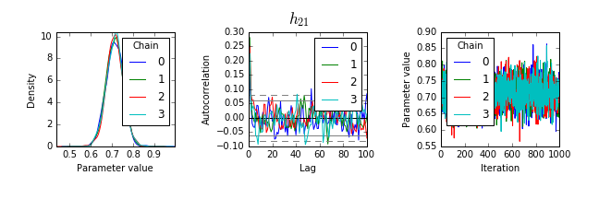
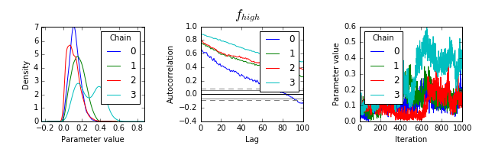
Diagnostics: Has your numerical simulation “not-not” converged?

Slide 22

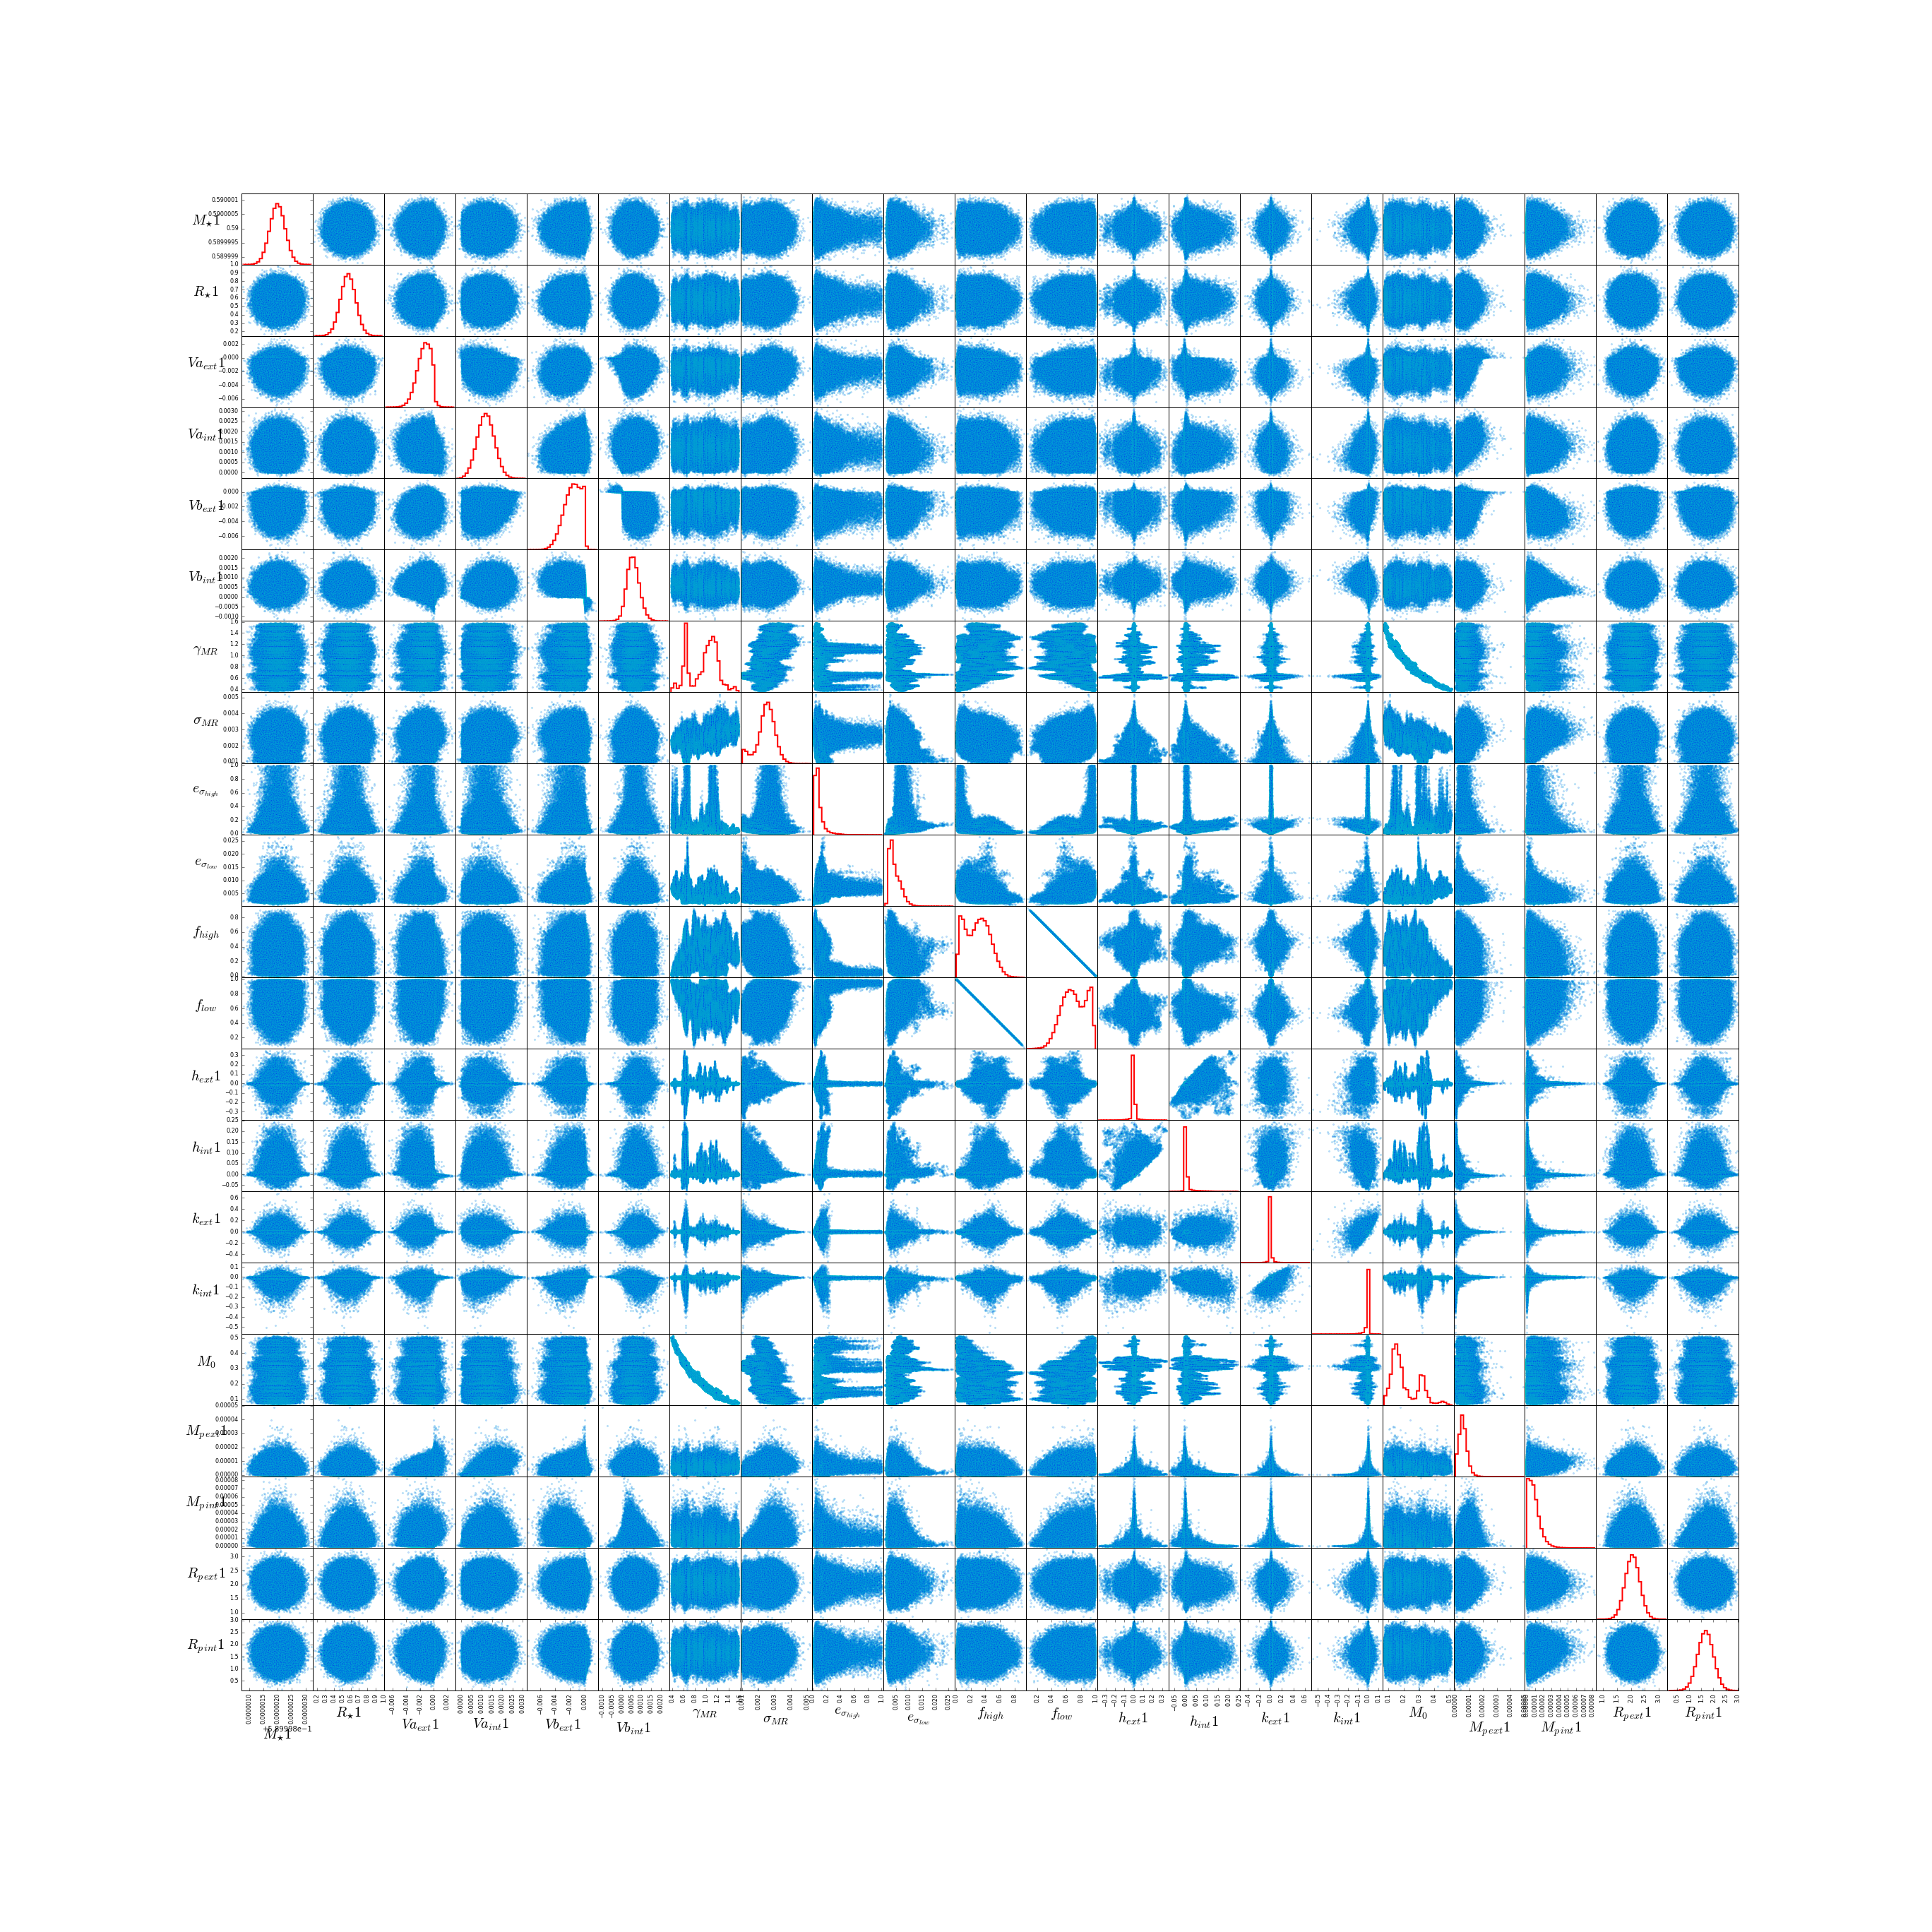
Diagnostics: Has your numerical simulation “not-not” converged?

Slide 23
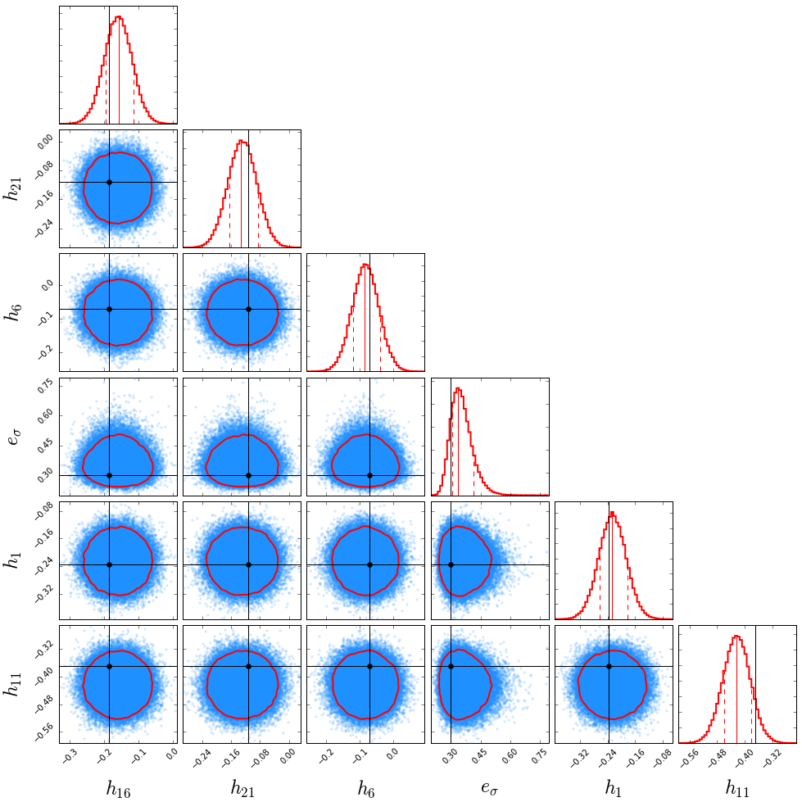
Diagnostics: Has your numerical simulation “not-not” converged?
Over-plot truths from simulated data

Slide 24
Workflow Best Practices
The model you choose depends on the science question you ask ahead of time.
E.g “Researcher degrees of freedom”
Conditional probability
Are parameters and hyperparameters separable?
The mathematical artifacts when sampling your model applied to your data are important, diagnostics are still being developed.
Some solutions:
Take out predictor variables that are highly correlated with each other when tailoring your numerical simulation
Conjugate priors for computational tractability (set of all densities to choose from (for prior) having the same functional form as likelihood)

Slide 25
Things to Keep in Mind:
Fractional Uncertainty
There are more parameters in your HBM than there are data points.
Conditional probability -> weighting something by something else -> multiplying -> log Likelihood is a very large negative number (not normalized) -> Smaller large negative number has higher probability.
Regularization (e.g., spread in planet mass at a given radius) naturally handles over-fitting
Philosophy: Prediction or Statistical Significance?

Slide 26
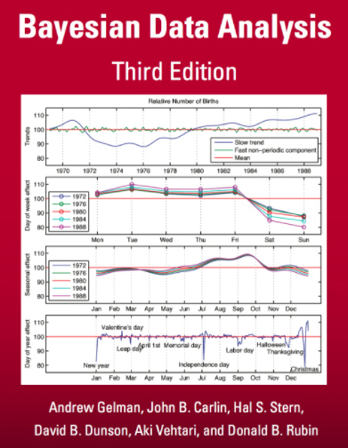
Selected Reference Material
Bayesian Data Analysis, Gelman, Carlin, Stern, & Rubin

Slide 27
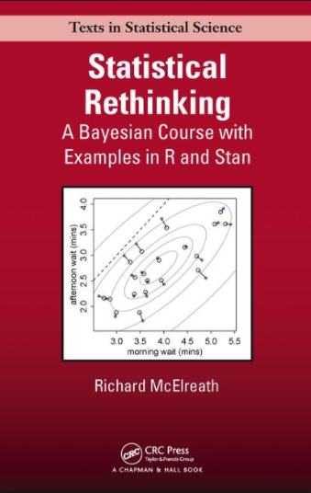
Selected Reference Material
Statistical Rethinking: A Bayesian Course with Examples in R and Stan (Self directed learning)

Slide 28
Selected Reference Material
Stan – Case Studies: Open-source Models and Methods http://mc-stan.org/users/documentation/case-studies

Slide 29
Hierarchical Bayes and Open Reproducible Science
P-hacking: “…the problem: weak statistical standards of evidence for claiming new discoveries”
Big names in statistics want to shake up much-mailigned P value
Researchers Degrees of Freedom: “…when we look at exploratory results, we must be aware of their uncertainty and fragility.”
The garden of forking paths: ... Andrew Gelman and Erik Loken 2013
There’s no finality in Science: “All data requires interpretation, which is subject to bias, and all results are preliminary.”
Interesting opinion article in Scientific America
HBM: Can incorporate bias in a quantitative manner.
Modeling languages allow transparency in research workflow (e.g., JAGS, Stan, TensorFlow, and more).

